Slide 1
Cloud Service Models

Slide 2
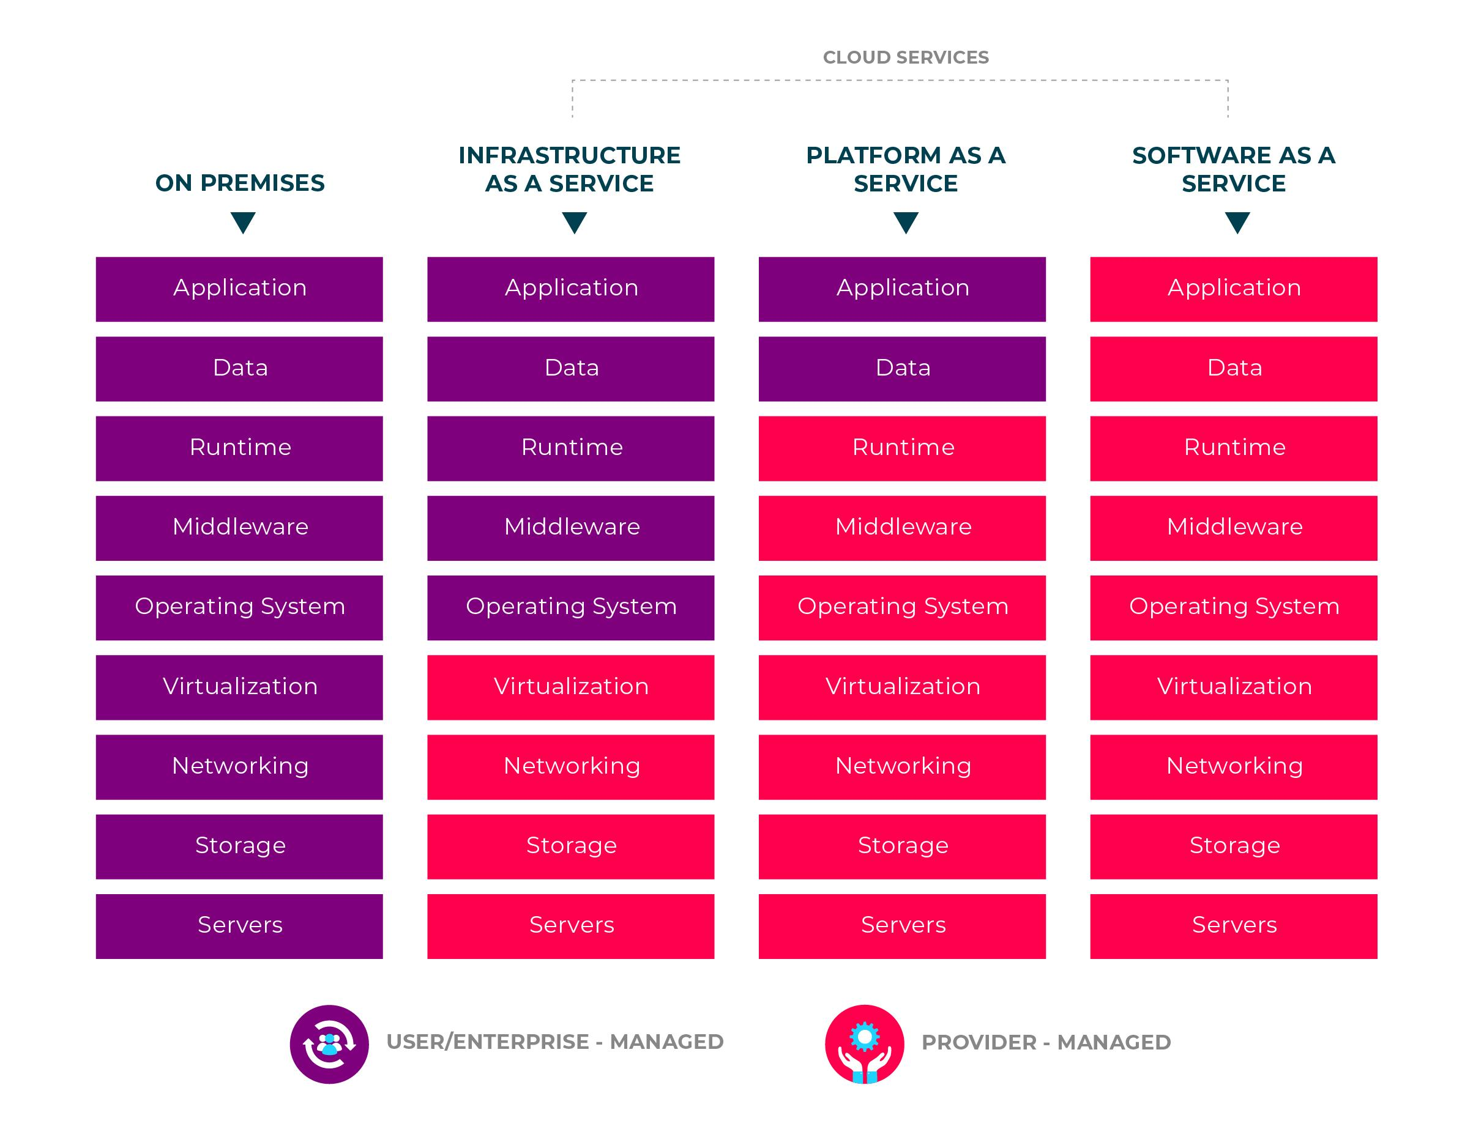
Cloud Service Models
Three main service models in the cloud:
Infrastructure as a Service
Platform as a Service
Software as a Service

Slide 3
Infrastructure as a Service (IaaS)
computing infrastructure that can be provisioned and managed over the internet
pay for what you use
allows quick scaling up or down
burden of buying and managing physical infrastructure is eliminated – no CapEx
three main IaaS providers:
Google Cloud Platform
Amazon Web Services
Microsoft Azure
aimed at developers

Slide 4
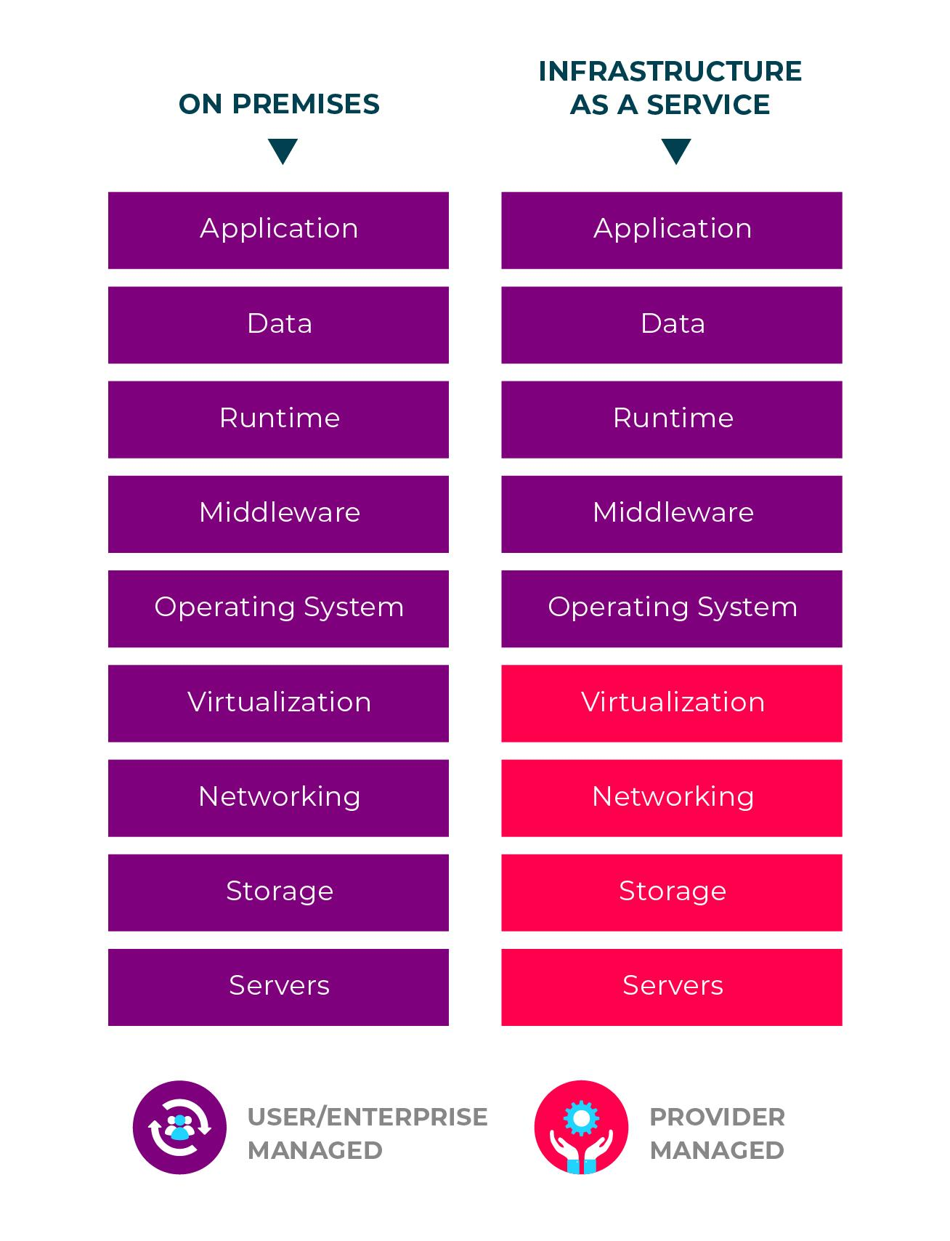
IaaS Responsibility
Cloud Provider manages the infrastructure level
Consumer is responsible for:
Software
Installation
Configuration
Management
Middleware
Applications

Slide 5
IaaS Business Scenarios
Testing and development
Website hosting
Storage, backup and recovery
Performance computing (such as for weather and climate simulation)
Big Data

Slide 6
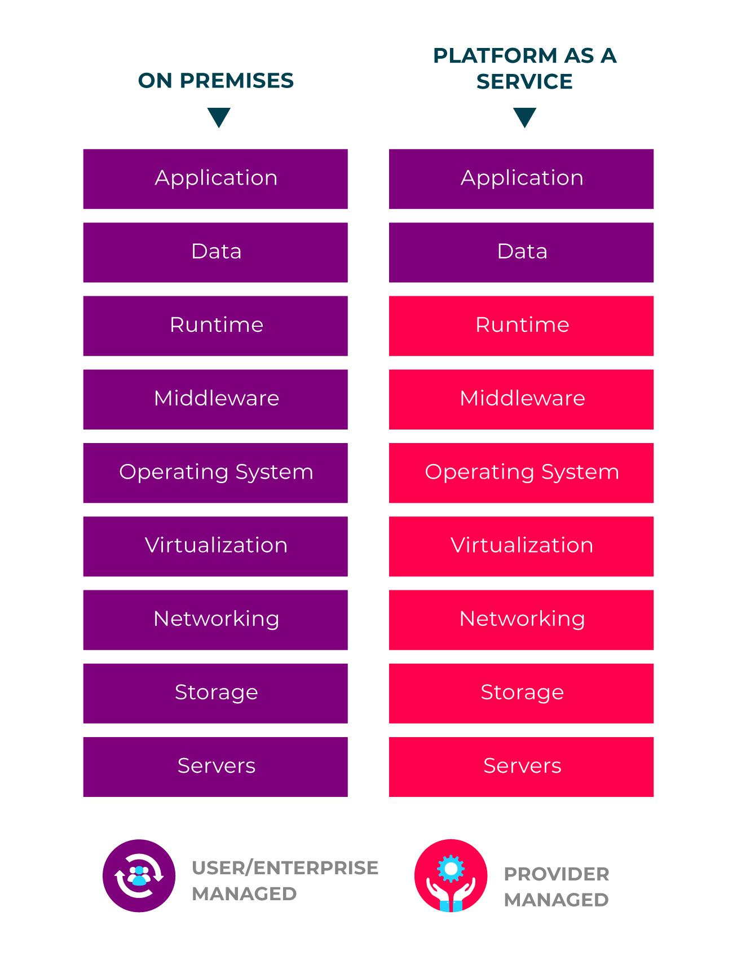
Platform as a Service (PaaS)
Offerings with all the resources you need for development or deployment of Cloud-based applications
purchased on a pay-as-you go basis
applications and services that are being developed remain the responsibility of the user
everything else is the responsibility of the cloud provider
No need to provision compute resource, virtual networks, etc.

Slide 7
PaaS Business Scenarios
Development framework
a framework is provided for the development of Cloud applications.
Applications can be created through the built in software components.
Features such as: scalability, multi-tenancy, and high-availability are included and managed by PaaS
Business intelligence and analytics
tools are provided for data mining, finding patterns, investment returns and for many more business related needs
Additional services
services that provide advice in regards to networking, security, scheduling, etc.

Slide 8
Software as a Service (SaaS)
allows everyone to connect to Cloud-based applications over the internet
Common examples of SaaS applications would be:
Gmail
Netflix
Office 365
pay-as-you-go service
complete software solution from a chosen Cloud provider
able to rent an application, which you or your users are then able to access through the internet

Slide 9
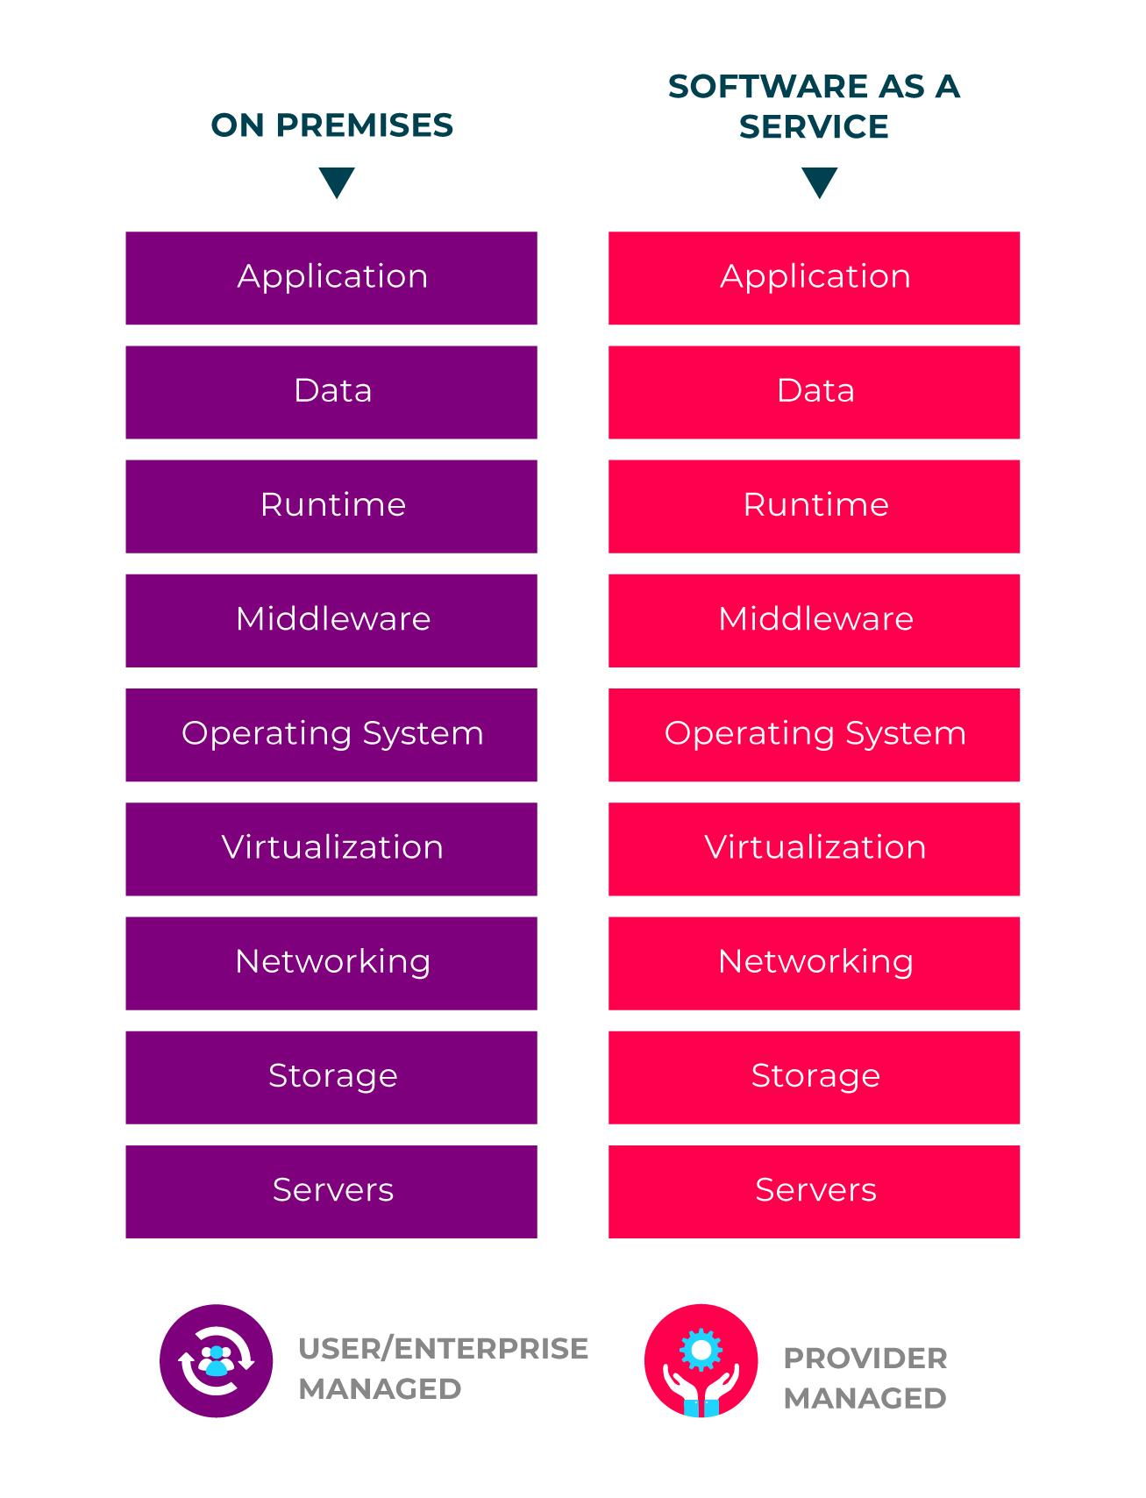
SaaS Responsibility
Cloud service provider is responsible for managing all aspects of the service that is provisioned, including availability, hardware, software, security, data, etc.

Slide 10
SaaS Business Scenarios
Email services
Licencing an application suite to members of a business
e.g. Office 365
Customer Relationship Management (CRM) and Enterprise Resource Planning (ERP) software

